Slide 1
SharePoint APIs
Microsoft Graph

Slide 3
How to View This Presentation
To switch to Notes Page view:
While in edit mode, click the View tab within the ribbon, and then click Notes Page
To navigate through notes, use the Page Up and Page Down keys
Zoom in or zoom out, if required
In the Notes Page view, you can:
Read any supporting text—now or after the delivery
Add notes to your copy of the presentation, if required
Take the presentation files home with you

Slide 4
Overview
What is Microsoft Graph
In this Lesson
How to use Microsoft Graph
When to use Microsoft Graph

Slide 5
Objectives
Learn about MS Graph
Get familiar with where it is used
Know when to use it for your customizations
Discover how it can be used

Slide 6
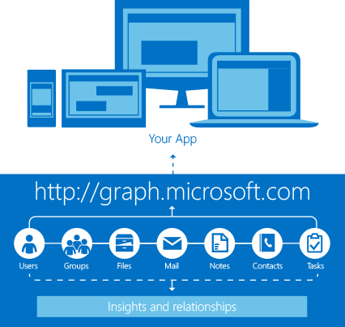
Microsoft Graph API
Not available for on-premises SharePoint
Allows access to most services under Office 365 including accessing files and list data
Utilizes REST, OData and OAuth
https://graph.microsoft.com
Notes:
The Microsoft Graph API is only available when using Office 365. There is no equivalent for on-premises SharePoint farms.
It allows easy access to most of the many services covered under the Office 365 suite with just one single authentication token and through one single API.
Microsoft Graph utilizes the industry standards REST, OData and OAuth security to exchange data.

Slide 7
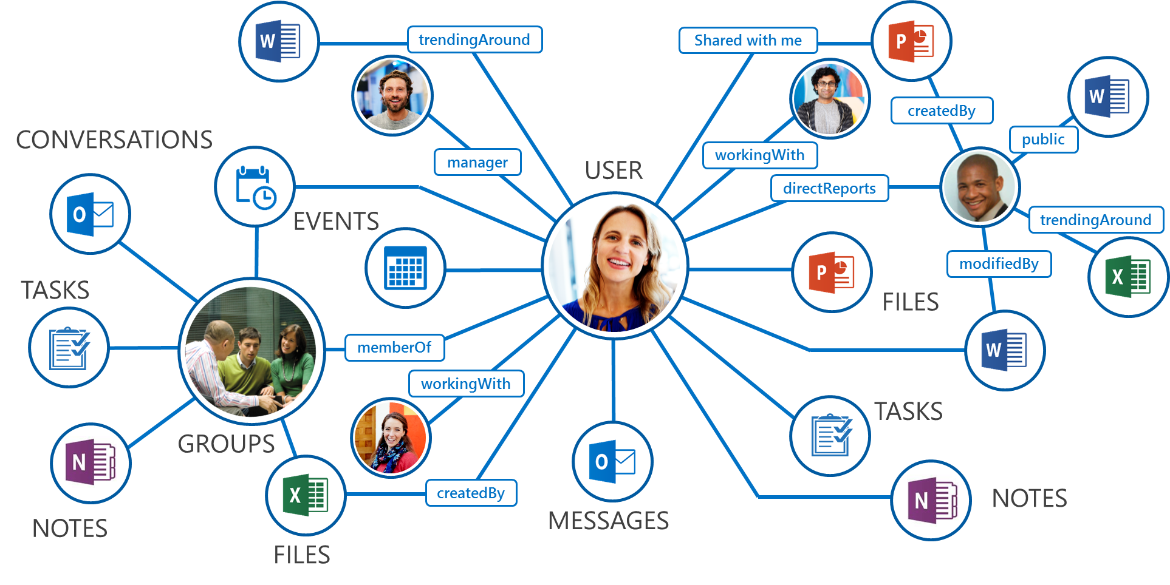
What is in the Graph?
Resources connected by relationships
E.g. Delve profile connects you to teammates through your manager
Intelligent insights about data
E.g. Delve discovers documents from people around you
Notes:
Make your data more intelligence by building relationships and insights about the resources.

Slide 8
When to Use MS Graph
Azure AD - profile information, photos, etc.
O365 Groups & Teams - view and provision
Outlook - calendar events, mail, tasks, contacts, etc.
Office Online - Excel & OneNote contents
SharePoint & OneDrive - lists, folders, items, permissions, etc.
Planner - tasks, buckets
Insights - trends or forecasts
Relevance - sorting or filtering
RESTful Operation & OAuth - use in another application
Notes:
More and more resources of Microsoft products are getting exposed through the Microsoft Graph API. For a full list of all endpoints available today, check out the API reference:
https://docs.microsoft.com/en-us/graph/api/overview?view=graph-rest-1.0
The menu on the left nicely shows which types of objects can be worked with through the Microsoft Graph API.
In the changelog you can see if endpoints get added or changed:
https://docs.microsoft.com/en-us/graph/changelog

Slide 9
Use the Microsoft Graph API
Calling the API
https://graph.microsoft.com
/{version}/{resource}/{id}/{property}?{query-parameters}
HTTP verbs: GET | POST | PATCH | DELETE
Version: v1.0 or Beta
Resource: users, groups, sites, drives, devices, more…
Member from collection: users/AAA
Property: users/AAA/department
Traverse to related resources via navigations: users/AAA/events
Format results: $select | $orderby
Control results: $filter | $expand
Paging: $top | $skip | $skiptoken
Notes:
In order to use your newly created App, you need to authorize access to the v2.0 endpoint on behalf of the user.
For more information on token requests: https://docs.microsoft.com/en-us/graph/auth-v2-user

Slide 10
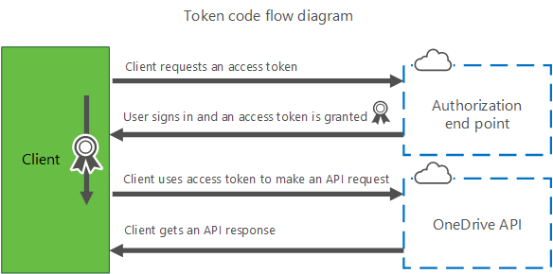
Authenticating with the Graph API
Graph API isn’t for “Anonymous Access”…
Register your application with Azure AD
Grant permissions to Graph API
Store application configuration in local solution
Have users authenticate with Azure AD to get access token
Call Graph API with access token
Do something with results
More on auth-flow later…
Notes:
Graph API isn’t for anonymous access.

Slide 11
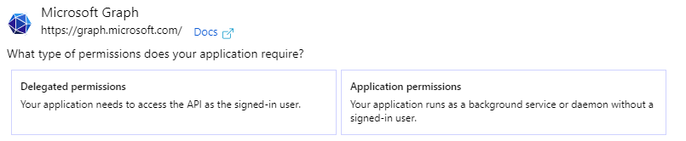
Two Types of Authentication
Users vs Applications
Interactive Logins
User delegation identity
Can access the “me” resources
The application pretends to be a user
Non-interactive Logins
Application identity
Cannot access the “me” resources
The application has its own identity
Notes:
When granting permissions to your Azure AD App Registration, you can choose between delegated permissions and application permissions. Delegated permissions means there will be an app + user context, thus the user needs to log on before such a token can be granted. Application permissions means it runs as an application using an app-only context. No user needs to log on in this scenario. This is used for service applications to consume data from the Graph API or write back to it.

Slide 12
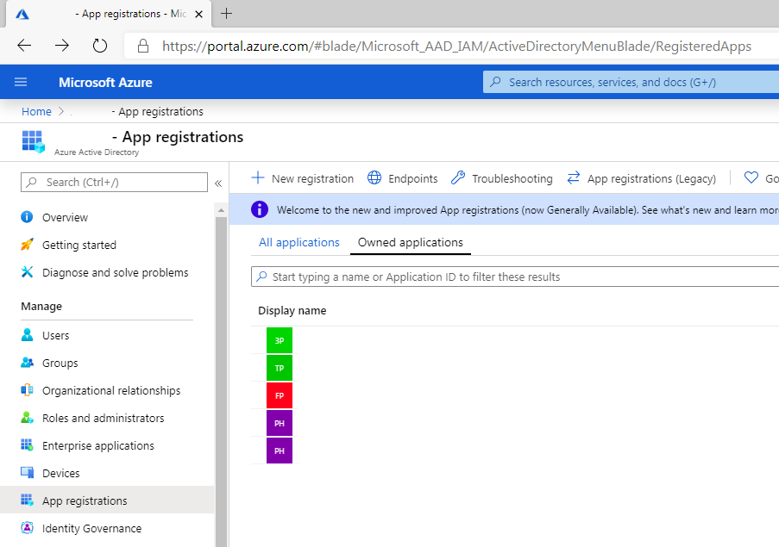
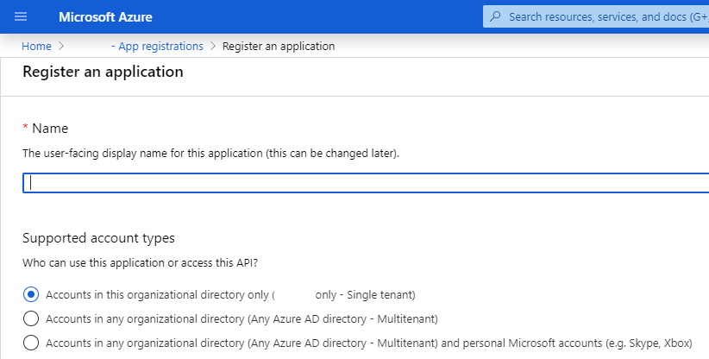
Registering your app in Azure Active Directory
Go to Azure Active Directory: https://aad.portal.azure.com
App registrations
New registration
Notes:
In order to use MS Graph with your application, you need to first register the app with Azure AD. You can do this by logging in to https://portal.azure.com, going into your Azure Active Directory component, clicking on App registrations and clicking New registration.
For more information on full app registration and endpoint considerations: https://docs.microsoft.com/en-us/graph/auth-register-app-v2

Slide 13
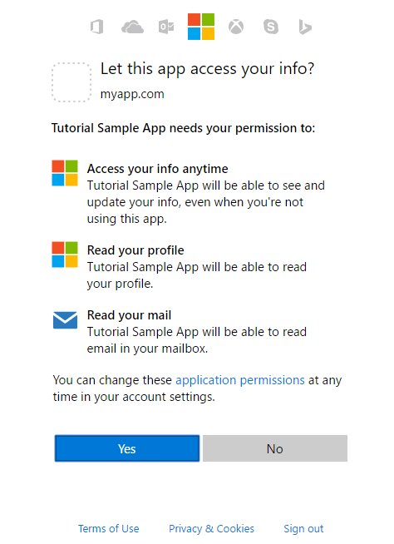
Delegated Permission Request
Get Authorization – v2.0 Delegated
Redirect user to /authorize endpoint
Permissions requested using scope parameter
https://login.microsoftonline.com/{tenant}/oauth2/v2.0/authorize? client_id=6731de76-14a6-49ae-97bc-6eba6914391e &response_type=code &redirect_uri=http%3A%2F%2Flocalhost%2Fmyapp%2F &response_mode=query &scope=offline_access%20user.read%20mail.read &state=12345
User enters credentials & agrees to consent
Response with authorization code parameter
GET http://localhost/myapp/?code=M0ab92efe-b6fd-df08-87dc-2c6500a7f84d &state=12345
Notes:
In order to use your newly created App from a single page app, web app, mobile or desktop app, 3rd party api; you need to authorize access to the v2.0 endpoint on behalf of the user or delegated permissions. For more information on token requests: https://developer.microsoft.com/en-us/graph/docs/concepts/auth_v2_user
There is a second type of authentication which gets access from a service. This is called application permission types and only admins can consent.

Slide 14
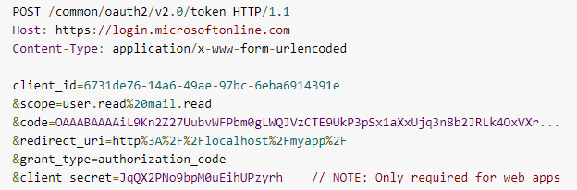
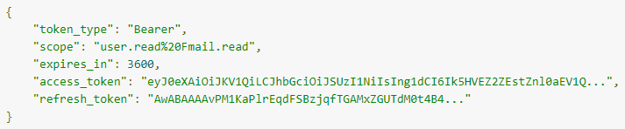
Delegated Permission Request
Get Token – v2.0 Delegated
App uses code at /token endpoint
Token POST request
Token response
Notes:
In order to use your newly created App, you need to authorize access to the v2.0 endpoint on behalf of the user.
For more information on token requests: https://developer.microsoft.com/en-us/graph/docs/concepts/auth_v2_user

Slide 15

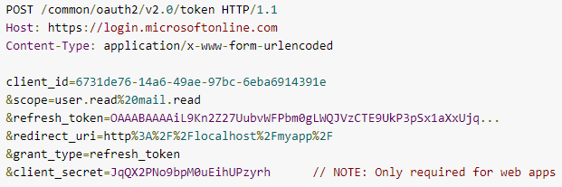
Use the Microsoft Graph API
Use Token to Call MS Graph - v2.0
Include the token in Authorization header of the request
Use Refresh Token to Get New Token – v2.0 Delegated
Submit another POST request to the /token endpoint
Provide refresh token instead of code
Token response(similar to previous slide)
Notes:
In order to use your newly created App, you need to authorize access to the v2.0 endpoint on behalf of the user.
For more information on token requests: https://developer.microsoft.com/en-us/graph/docs/concepts/auth_v2_user

Slide 16
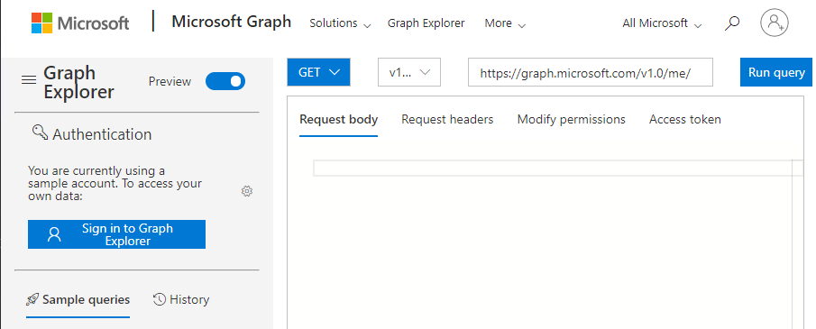
How to Use Graph Explorer
https://developer.microsoft.com/en-us/graph/graph-explorer/preview
‘Sign in to Graph Explorer’
Start running queries
View Responses
Notes:
Similar to a tool like PostMan, Graph Explorer is a great way to start building and testing queries using MS Graph. However, it does not require you to download and install; it is available within the browser.

Slide 17
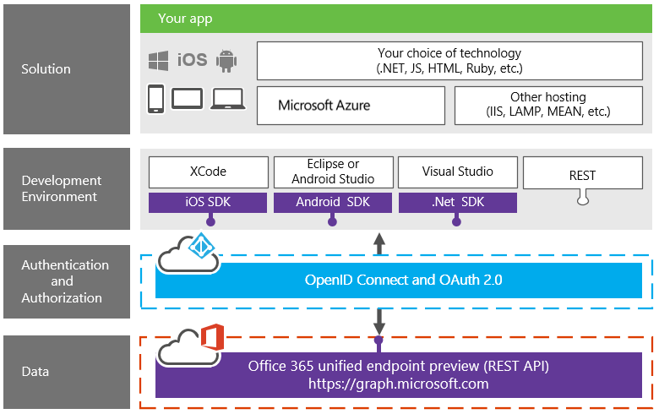
Microsoft Graph Quick Start
Templates for several platforms
Sample with access to Azure AD, OneDrive, and Outlook
Notes:
Each quick start pulls information from an Azure AD user profile, writes it to OneDrive (a photo), and sends an email using Outlook (including a link to the photo).
https://developer.microsoft.com/en-us/graph/quick-start
Pick a platform
Get an app ID and secret(dependent on your Office 365 Admin – some block access to Graph API so you may have to request a Global Admin to create one and grant you rights)
Start coding – download the SDK-based or REST-based code sample

Slide 18
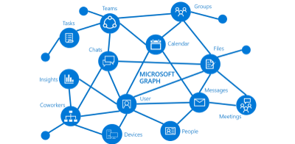
MS Graph API Best Practices
Sample the quality of your enterprise data
Many apps rely on good directory data
Code defensively against holes
Store custom data in MS Graph
Chain calls for efficient queries
Utilize webhook subscriptions to monitor changes
Notes:
You can only pull information if it exists. E.g. missing profile photos, manager info, etc. If your enterprise data is not well-formed, pull in hr lob systems that might have better information.
Instead of building a seperate SQL instance, store your data inside the Graph itself. Batch your calls to reduce how many times you have to call information about the same object. Graph webhooks can be used vs. calling data multiple times. E.g. monitoring when a new email is submitted.
Subscriptions information: https://docs.microsoft.com/en-us/graph/auth-v2-user
MS Graph we hook samples: https://github.com/microsoftgraph/nodejs-webhooks-rest-sample, https://github.com/microsoftgraph/aspnet-webhooks-rest-sample
Azure Functions Demo from 2017: https://www.youtube.com/watch?v=Y3cC0Hpemmk

Slide 19
Popular Requests
Operation | URL
GET my profile | https://graph.microsoft.com/v1.0/me
GET my files | https://graph.microsoft.com/v1.0/me/drive/root/children
GET my photo | https://graph.microsoft.com/v1.0/me/photo/$value
GET my mail | https://graph.microsoft.com/v1.0/me/messages
GET my high importance email | https://graph.microsoft.com/v1.0/me/messages?$filter=importance%20eq%20'high'
GET my calendar events | https://graph.microsoft.com/v1.0/me/events
GET my manager | https://graph.microsoft.com/v1.0/me/manager
GET last user to modify file foo.txt | https://graph.microsoft.com/v1.0/me/drive/root/children/foo.txt/lastModifiedByUser
Notes:
Me is whoever is logged into the application or calling the REST API. Pass id or use request uri to impersonate another user.

Slide 20
Popular Requests
Operation | URL
GET Office365 groups I’m member of | https://graph.microsoft.com/v1.0/me/memberOf/$/microsoft.graph.group?$filter=groupTypes/any(a:a%20eq%20'unified')
GET users in my organization | https://graph.microsoft.com/v1.0/users
GET groups in my organization | https://graph.microsoft.com/v1.0/groups
GET people related to me | https://graph.microsoft.com/v1.0/me/people
GET items trending around me | https://graph.microsoft.com/beta/me/insights/trending
GET my notes | https://graph.microsoft.com/beta/me/onenote/notebooks
Notes:
More objects than me can be used to call information.

Slide 21
Examples of SharePoint Site Data
Get root site
GET https://graph.microsoft.com/v1.0/sites/root
Get site
GET https://graph.microsoft.com/v1.0/sites/{site-id}
Get site by path
GET /https://graph.microsoft.com/v1.0/sites/{hostname}:/{site-path}
Get site for a group
GET https://graph.microsoft.com/v1.0/groups/{group-id}/sites/root
Search for sites
GET https://graph.microsoft.com/v1.0/sites?search={query}
Get the collection of lists for a site
GET https://graph.microsoft.com/v1.0/sites/{site-id}/lists
Get collection of subsites for a site
GET https://graph.microsoft.com/v1.0/sites/{site-id}/sites
Notes:
This slide shows some sample Graph API queries that can be executed on a site: https://developer.microsoft.com/en-us/graph/docs/api-reference/v1.0/resources/site
Animation is configured on this slide so that it can be used as an interactive activity with the class. For example:
Click to start slide and click to show question 1: “who wants to tell us the syntax for a REST call that will retrieve all items in a specific list?”
Click to show and explain answer
Repeat steps 1 & 2
Alternatively, the entire slide can be exposed and discussed if needed.

Slide 22
Examples of SharePoint List Data
Get list
GET https://graph.microsoft.com/v1.0/sites/{site-id}/lists/{list-id}
Enumerate list items
Get https://graph.microsoft.com/v1.0/sites/{site-id}/lists/{list-id}/items
Update list item
PATCH /https://graph.microsoft.com/v1.0/sites/{site-id}/lists/{list-id}/items/{item-id}
Delete list item
DELETE https://graph.microsoft.com/v1.0/sites/{site-id}/lists/{list-id}/items/{item-id}
Create list item
POST https://graph.microsoft.com/v1.0/sites/{site-id}/lists/{list-id}
Get the collection of items in a list
GET https://graph.microsoft.com/v1.0/sites/{site-id}/lists/{list-id}/items?expand=fields(select=Name,Color,Quantity)
Notes:
This slide shows some sample Graph API queries that can be executed on a site for a list: https://developer.microsoft.com/en-us/graph/docs/api-reference/v1.0/resources/list
Animation is configured on this slide so that it can be used as an interactive activity with the class. For example:
Click to start slide and click to show question 1: “who wants to tell us the syntax for a REST call that will retrieve all items in a specific list?”
Click to show and explain answer
Repeat steps 1 & 2
Alternatively, the entire slide can be exposed and discussed if needed.

Slide 23
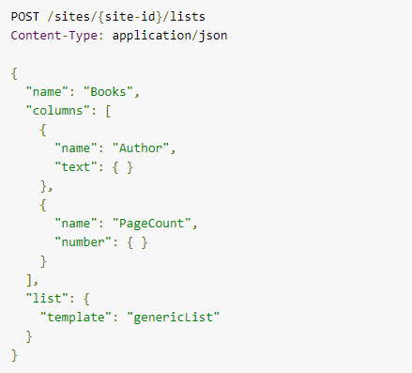
Examples of SharePoint List Data
Create a new list in a site
Notes:
Example from: https://developer.microsoft.com/en-us/graph/docs/api-reference/v1.0/api/list_create
Creates a new custom list named Books on a site with the columns: Author & PageCount.

Slide 24
Examples of SharePoint Item Data
Get list item
GET https://graph.microsoft.com/v1.0/sites/{site-id}/lists/{list-id}/items/{item-id}
Get column values
GET https://graph.microsoft.com/v1.0/sites/{site-id}/lists/{list-id}/items/{item-id}?expand=fields
Create list item
POST https://graph.microsoft.com/v1.0/sites/{site-id}/lists/{list-id}/items
Delete list item
DELETE https://graph.microsoft.com/v1.0/sites/{site-id}/lists/{list-id}/items/{item-id}
Update list item
PATCH https://graph.microsoft.com/v1.0/sites/{site-id}/lists/{list-id}/items/{item-id}
Update column values
PATCH https://graph.microsoft.com/v1.0/sites/{site-id}/lists/{list-id}/items/{item-id}/fields
Get a list item with metadata
GET https://graph.microsoft.com/v1.0/sites/{site-id}/lists/{list-id}/items/{item-id}?expand=fields
Notes:
This slide shows some sample Graph API queries that can be executed on a site list item: https://developer.microsoft.com/en-us/graph/docs/api-reference/v1.0/resources/listitem
Animation is configured on this slide so that it can be used as an interactive activity with the class. For example:
Click to start slide and click to show question 1: “who wants to tell us the syntax for a REST call that will retrieve all items in a specific list?”
Click to show and explain answer
Repeat steps 1 & 2
Alternatively, the entire slide can be exposed and discussed if needed.

Slide 25
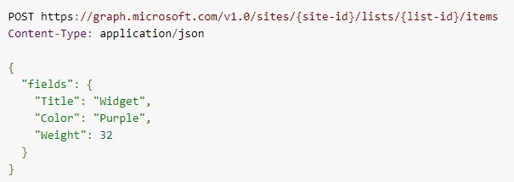
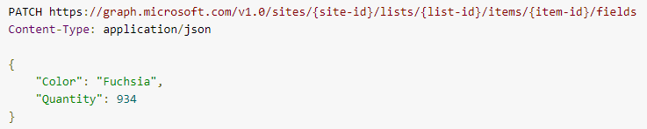
Examples of SharePoint List Item Data
Create a new list item in a list
Update list item
Notes:
Example from: https://developer.microsoft.com/en-us/graph/docs/api-reference/v1.0/api/listitem_create
Creates a new custom list named Books on a site with the columns: Author & PageCount.

Slide 26
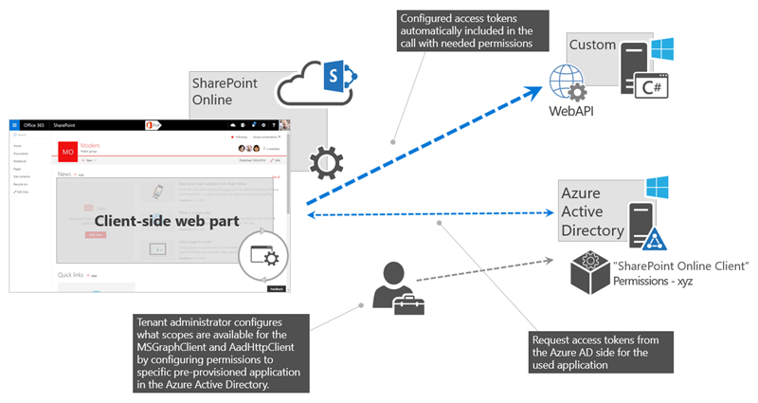
Other Ideas for MS Graph & Resources
Extend Flow with the Microsoft Graph
Connect to Graph from Power BI
Build a Graph API Connector for PowerApps
Connect to Graph from SharePoint Framework solutions
How some of our partners are using Microsoft Graph
Notes:
The ideas are endless here. You could build a web application for HR to be able to assign/revoke licenses users, custom org chart, custom external access request, trigger an azure function from your app, monitor your app with Graph Webhooks, etc.
https://docs.microsoft.com/en-us/azure/active-directory/develop/active-directory-graph-api
Concepts: https://github.com/microsoftgraph/microsoft-graph-docs/tree/master/concepts
SPFx React: https://github.com/SharePoint/sp-dev-fx-webparts/tree/master/samples/react-officegraph
Consume 3rd party API within SPFx: https://github.com/SharePoint/sp-dev-fx-webparts/tree/master/samples/react-3rd-party-api

Slide 27
Knowledge Check
Can MS Graph API be used from on-premises?
What are some best practices with MS Graph?
Where do developers go to register an app?
No
Azure Active Directory -> App registrations
Create a new SQL database to store any new attributes
Chain commands together using batches
Monitor changes using MS Graph webhooks

Slide 28
Lesson Summary
MS Graph API leverages O365 data insights and relationships
MS Graph API uses RESTful syntax
MS Graph API OAuth can be used from other apps
Following best practices can make your calls more useful

Slide 29
Questions?

Slide 30
Lab: Working with MS Graph
In this lab, you will learn how to use the Microsoft Graph Explorer to build queries against Microsoft Graph and create a contact in your address book, you will learn how to register an application in Azure Active Directory which allows the Microsoft Graph to be used to retrieve all Microsoft 365 Groups in your tenant and you will be writing a console application which pulls Outlook calendar data in using the Microsoft Graph SDK.
Time estimation: 45 minutes

